Slide 1
JOURNEY PRESENTATION
AASTHA SINGH (SS & ERM)

Slide 2
DAY 01-Azure Synapse
Azure Synapse Analytics is a cloud-based analytics service offered by Microsoft Azure.
It integrates data from different sources and provides a managed data warehousing solution for analyzing large volumes of structured data.
It's part of the Azure data services ecosystem, making it a powerful tool for data analytics and insights.
Data can be dead or alive. In dead-> Traditional, Big and New data.
It brings together the best of azure technologies used in data warehouse, apache spark and azure data explorer for log and times series analytics.
Synapse-dwh, big data and data explorer

Slide 3
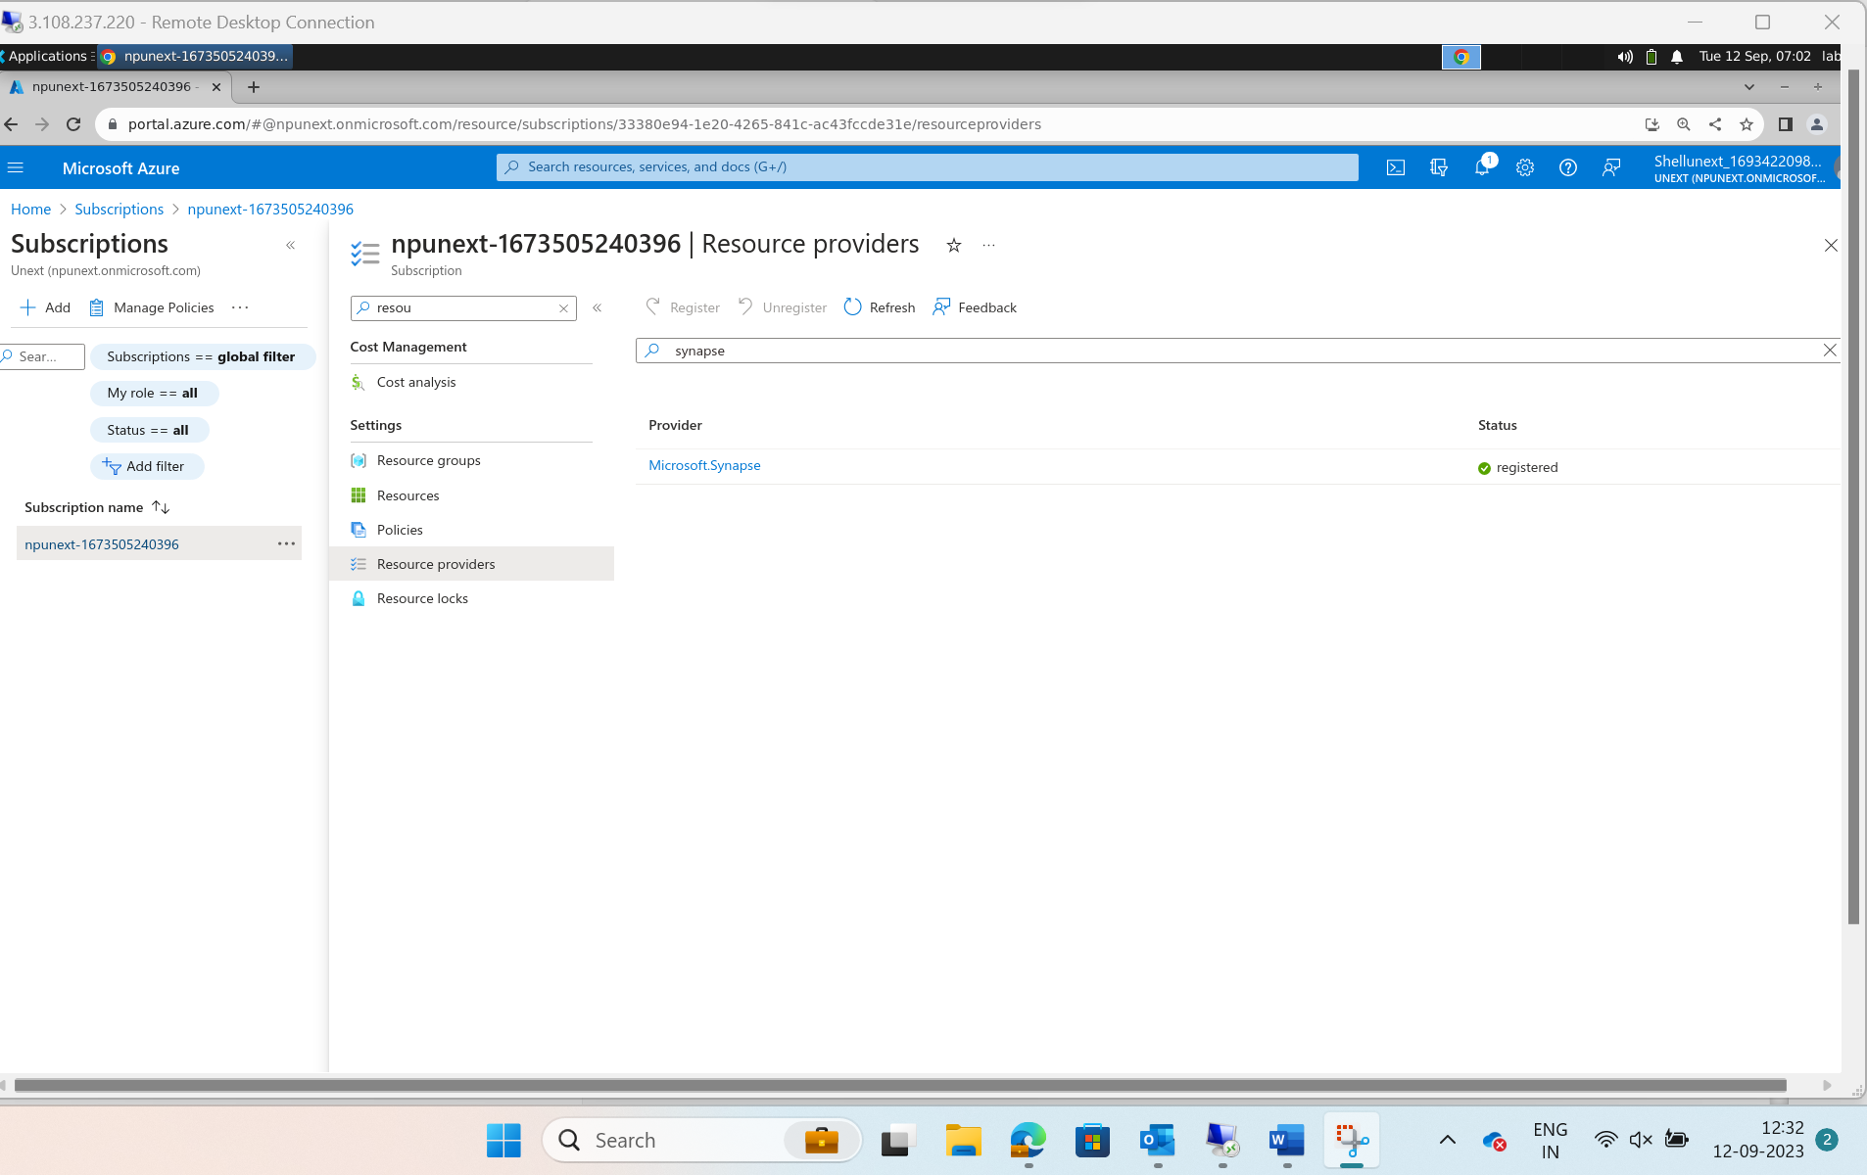
Develop

Slide 4
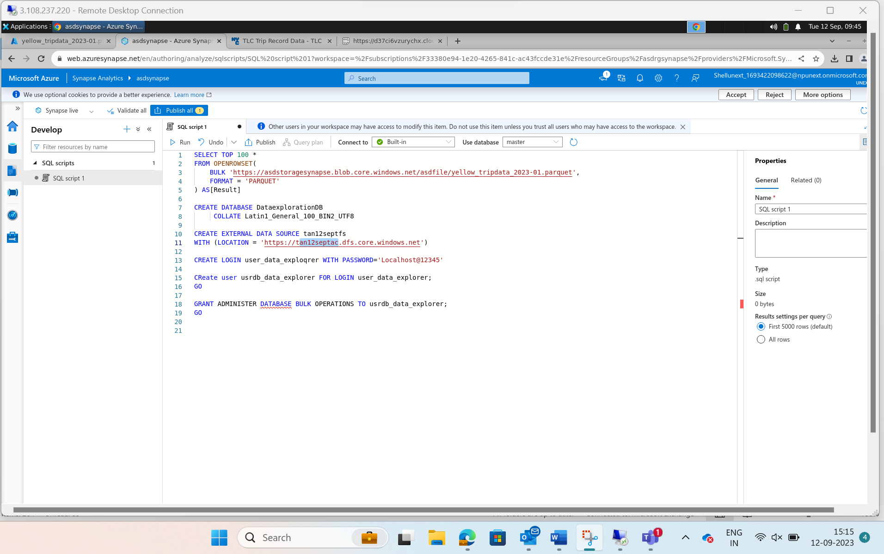

Slide 5
DAY 02 and 03-Power BI
Starts with Power BI lab today
In VM we need to open power bi lab and check whether we can copy and paste text and files from original desktops to remote desktop and the open sql and power bi softwares. In sql softwares we need to make sure that DB creation works. For it right click on db and create new db.
PowerBi-> Microsoft provide these 3 services
1. Desktop(easy and compact)
2. Service(Integration)->API, CLI,
3. Embedded mobile(light weight)
Target for today-> create a DB and connect it to PowerBI

Slide 6
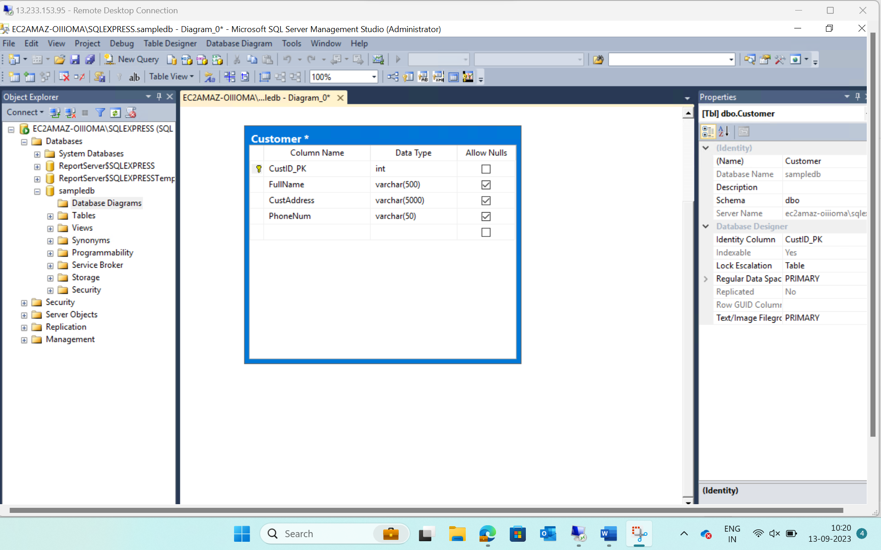

Slide 7
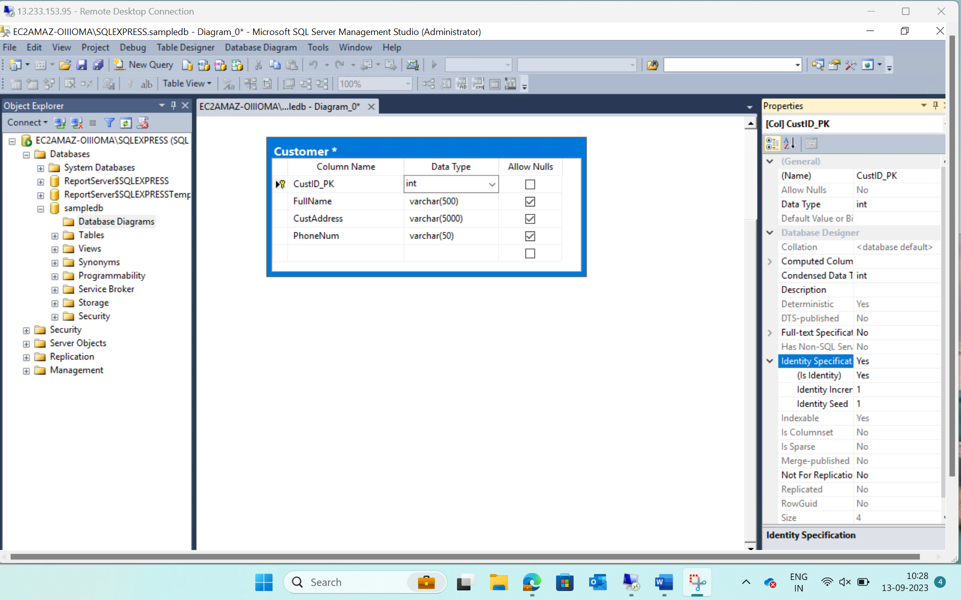

Slide 8
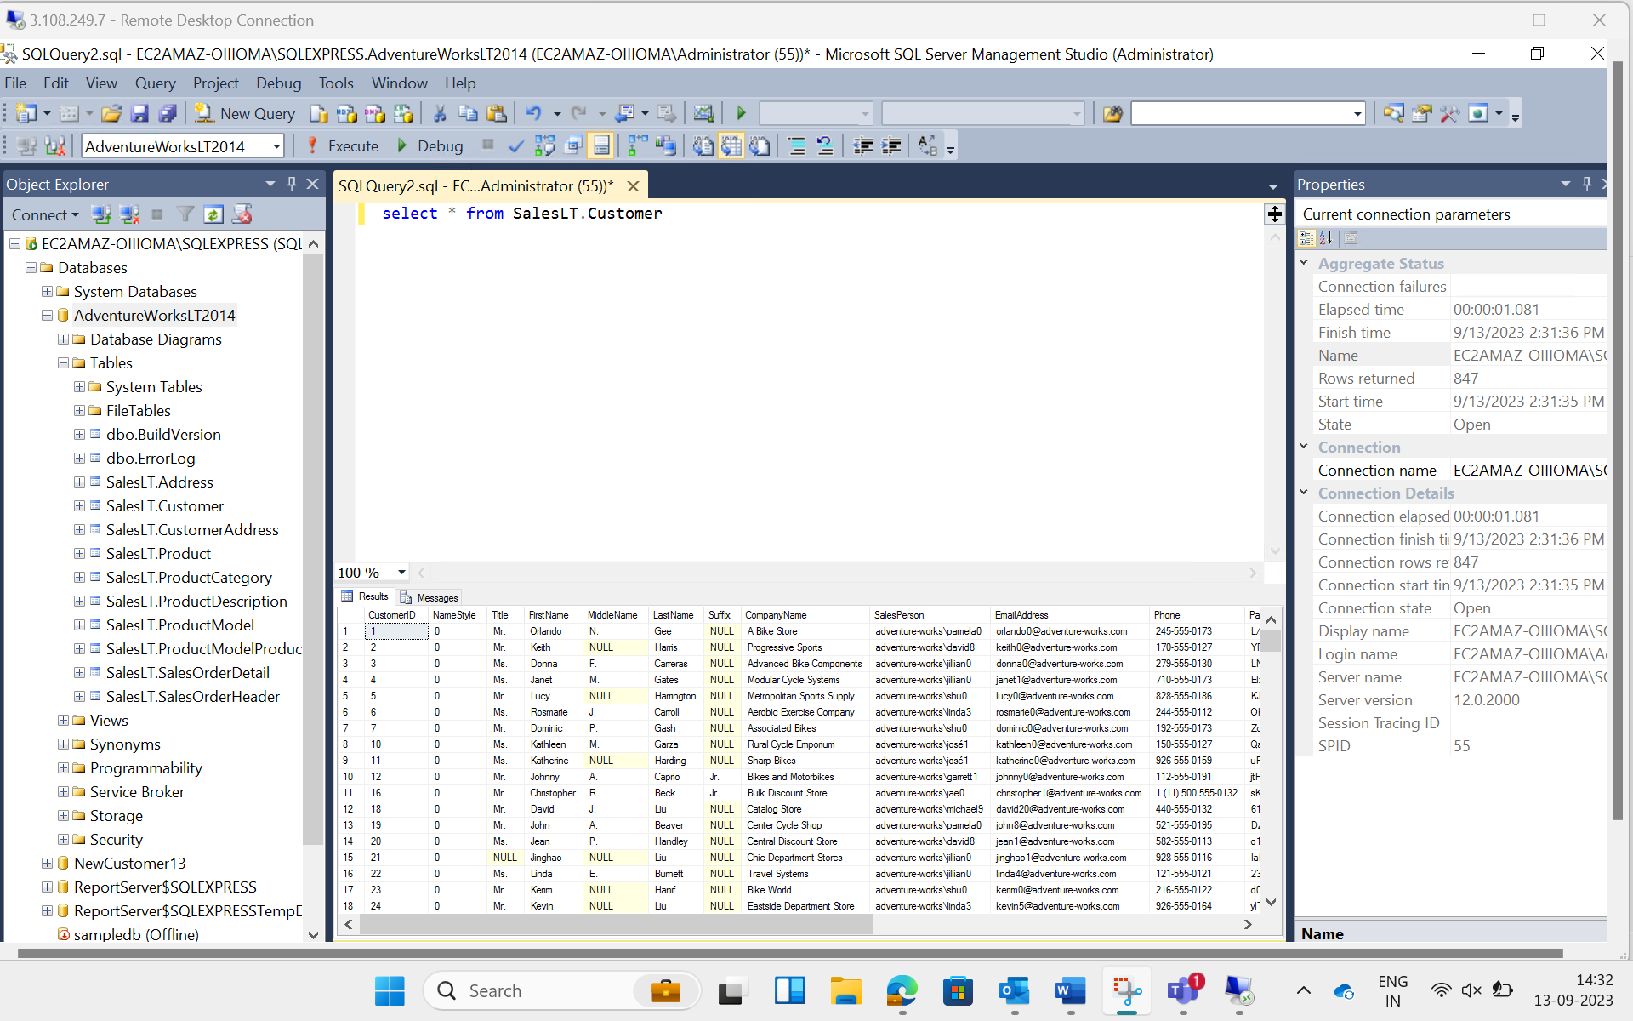

Slide 9
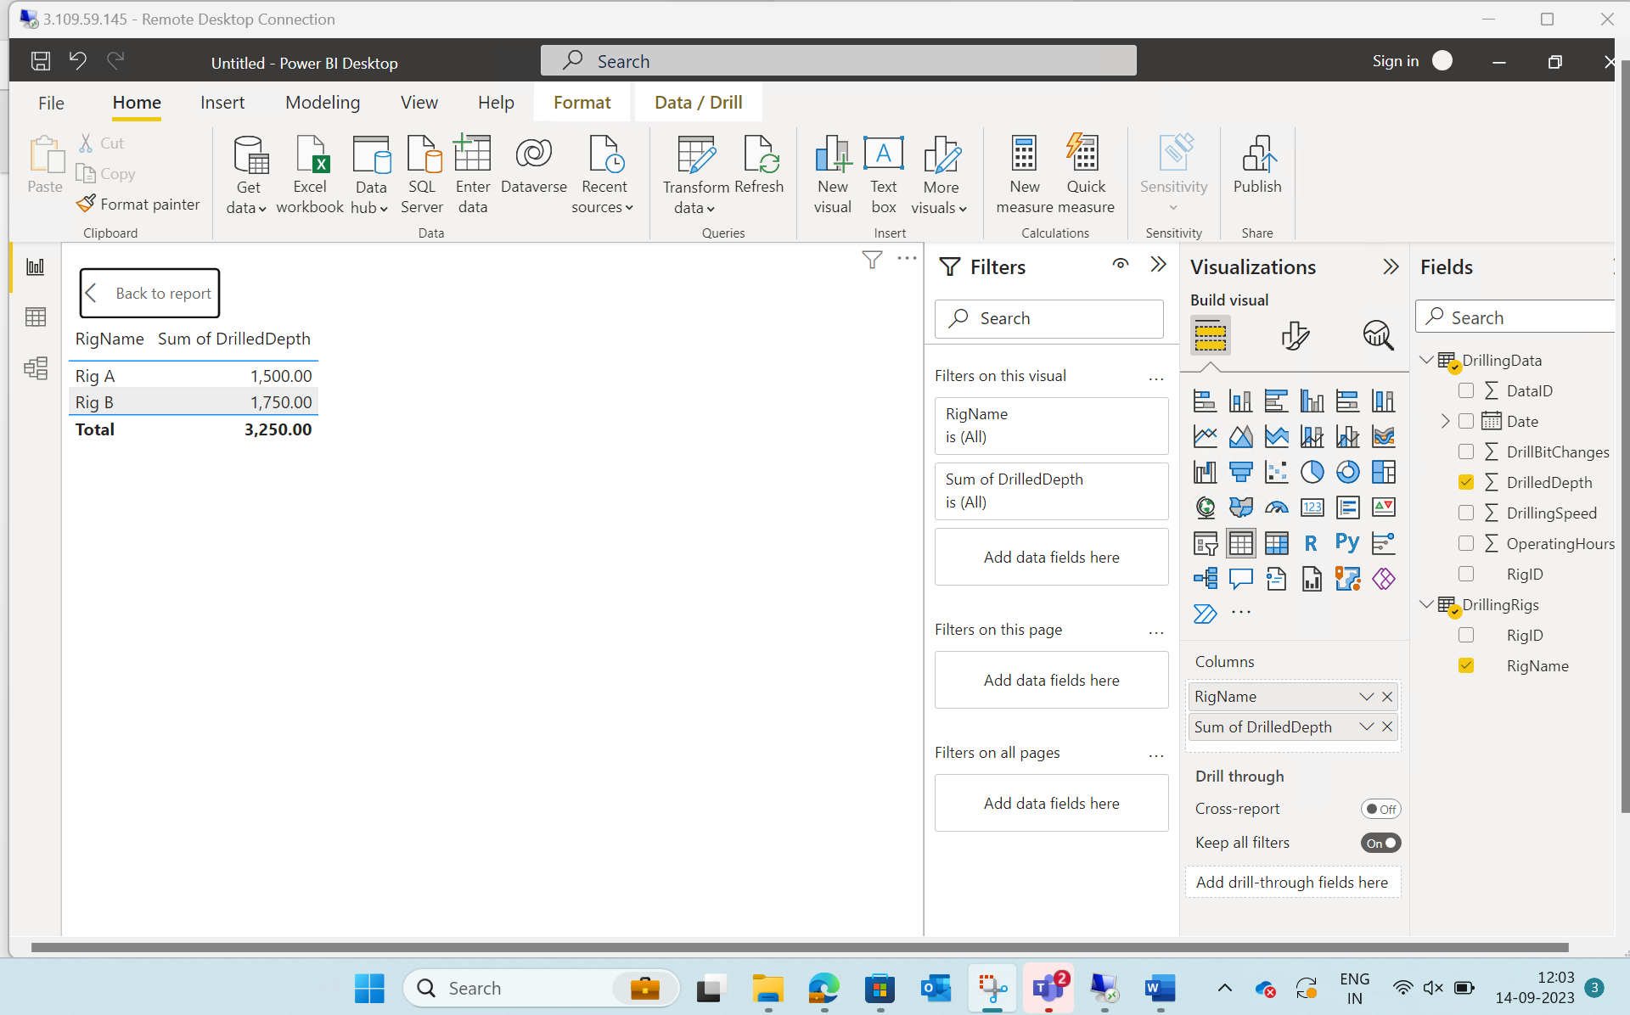

Slide 10
DAY 04-Power BI
Starts with Power BI lab today
Completed case study and continued with more PBI functions
Later day started with python basics.

